Slide 1
Python Data Visualization
Speaker: Johnny Jing-Chun Zang (詹景淳)

Slide 2
Outline
Data Visualization
Jupyter Notebook
Word Cloud
Line Chart
Heat Map

Slide 3
Introduction
Visualization. The conversion of invisible data into concrete graphics.
Visualizing data such as values, articles, or positioning information is called data visualization.
Data visualization usually uses statistical graphs, charts, or other tools.
We can use dots, lines, or bars to encode data to visually display quantitative information.

Slide 4
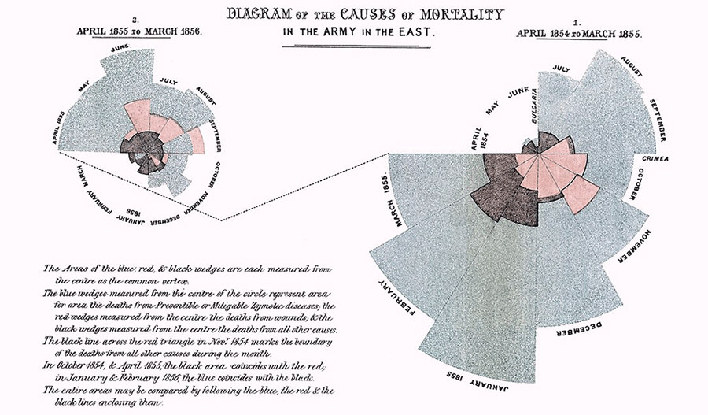
Example of Data Visualization
Reference: http://blog.infographics.tw/2016/02/nightingale-rose-chart/

Slide 5
Purpose of Data Visualization
Purpose of Data Visualization
Overview
Discover
Convey

Slide 6

Jupyter Notebook
Jupyter Notebook is an open-source integrated development environment built on a website.
Allow data scientists to write programs, display programs, and visualize the output.
Jupyter Notebook displays the execution results below the code, so it is very suitable for beginners to practice data visualization.
Reference: https://zh.wikipedia.org/zh-hk/Jupyter

Slide 7
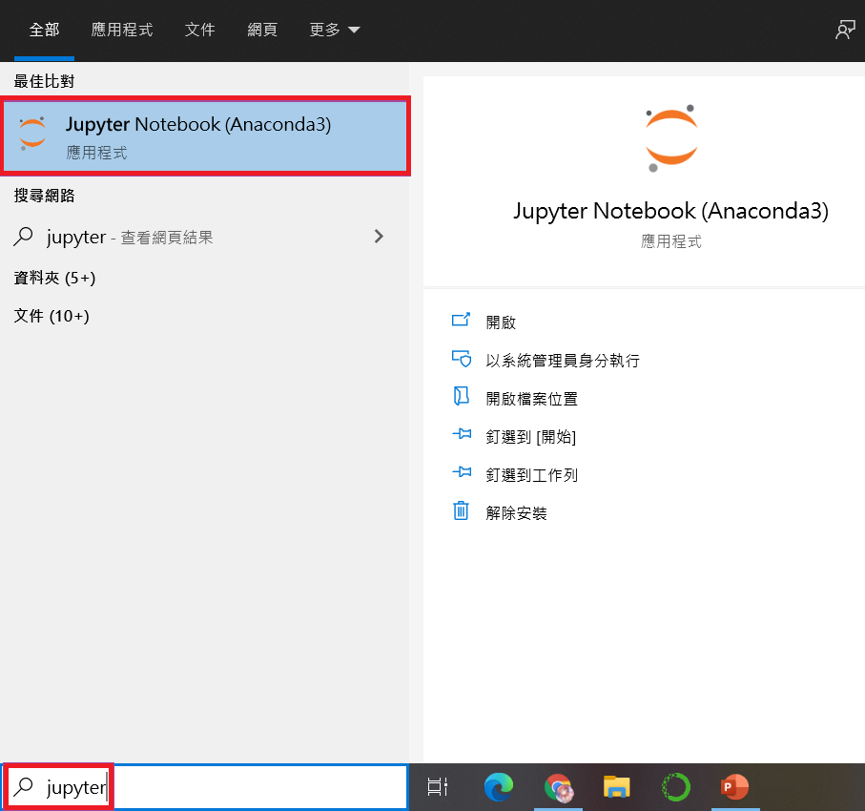
Open Jupyter Notebook
Search Jupyter on windows.
Click Jupyter Notebook to enter your localhost in the browser.

Slide 8
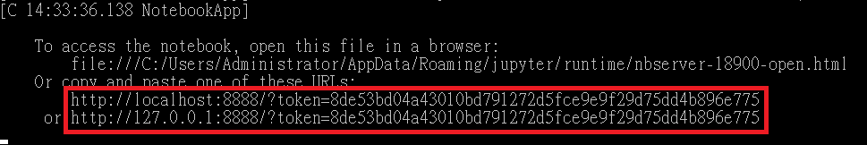
Change Browser
After clicking Jupyter Notebook, the default browser will be launched.
If you want to change the browser, you can copy the URL in the Prompt of Jupyter Notebook (in the red box of the picture), and then paste the URL into the browser you want to use.

Slide 9
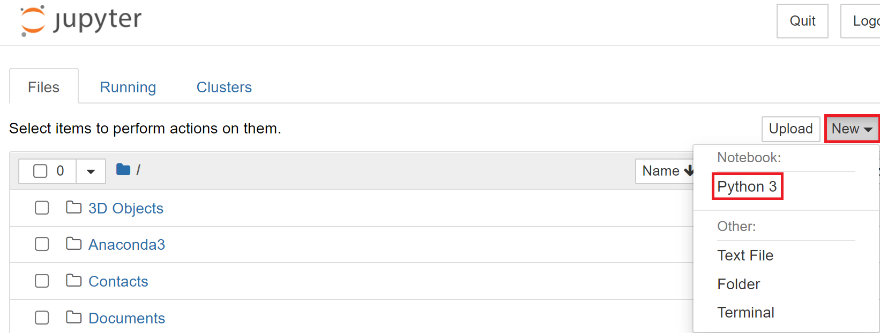
Create a New Notebook
Select "Python 3" from the "New" drop-down menu.

Slide 10
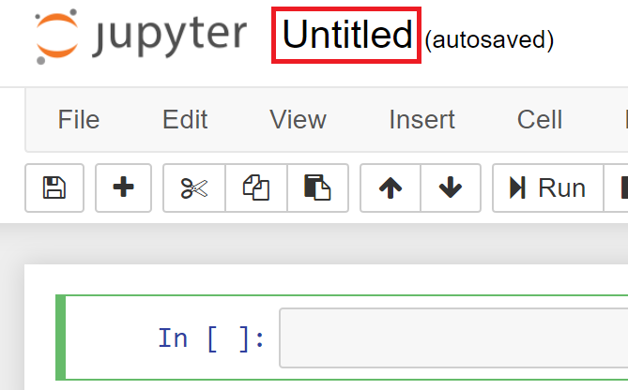
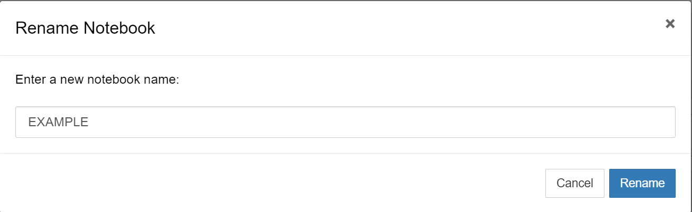
Change File Name
Click "Untitled" on the right side of the Jupyter logo and enter your new file name, click the "Rename" button to confirm that the file name update is complete.

Slide 11
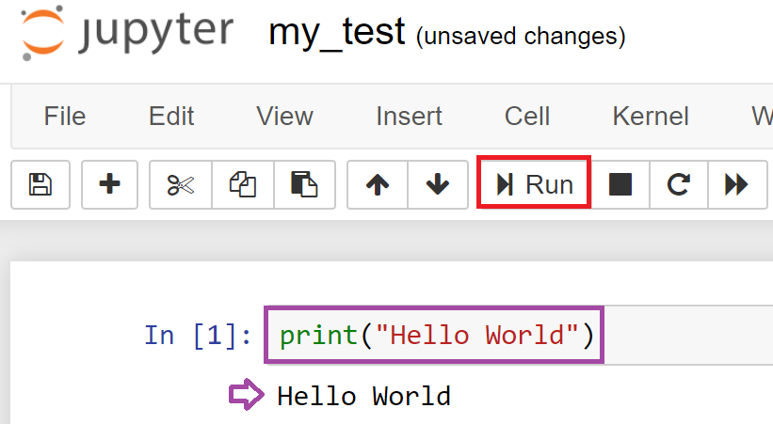
Program Execution
Please enter print("Hello World") in the cell.
Click "Run" to execute the program, or you can directly press "Shift" + "Enter" to execute.

Slide 12
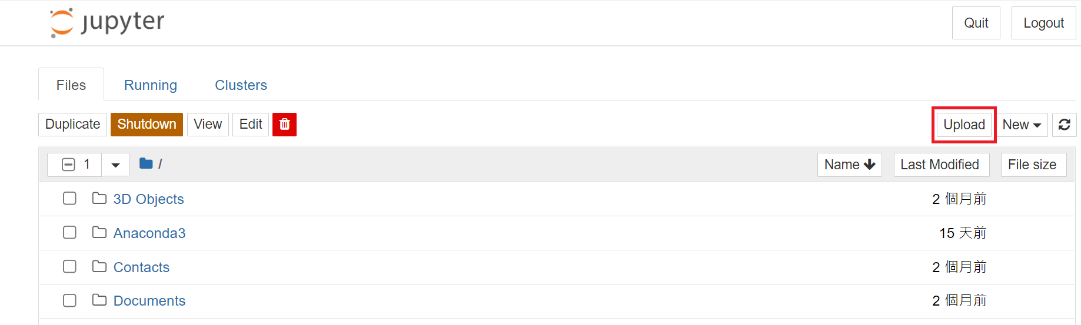
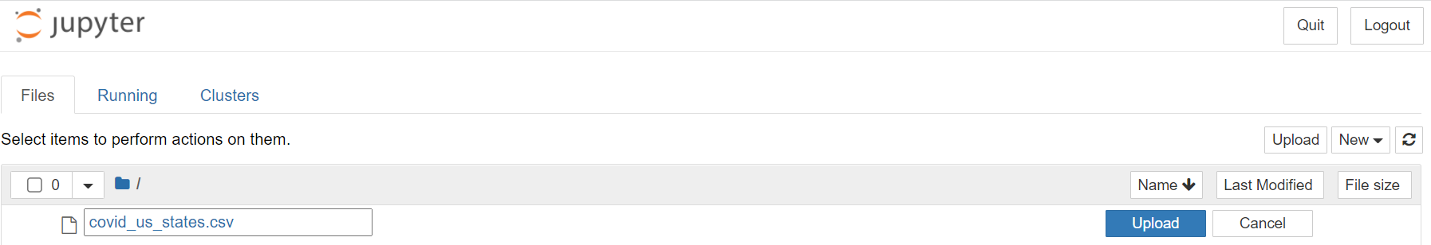
Upload File to Jupyter
Upload the files to Jupyter Notebook.

Slide 13
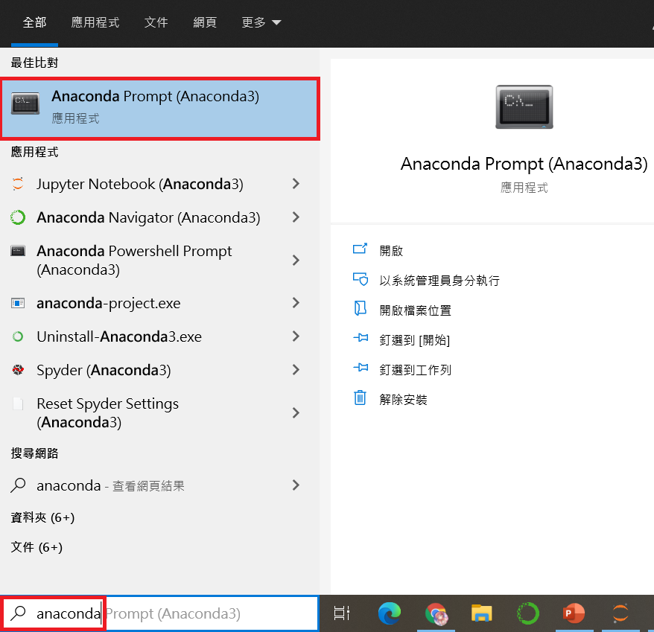
Install Library
Assuming an error occurs, please confirm whether the necessary library is installed.
Open Anaconda Prompt to install the library.

Slide 14
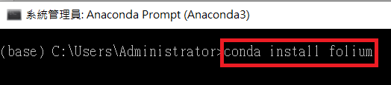
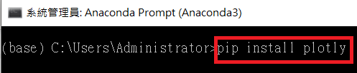
Install Packages
Enter conda install (library name) to install the necessary packages.
If you can't install it with the conda command, change it to pip install (library name).

Slide 15
Word Cloud
Use crawler tools to crawl the PTT website and draw the contents into a word cloud.

Slide 16
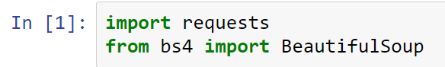
Crawler Library
requests is used to send HTTP requests and get responses.
BeautifulSoup is used to analyze and crawl elements in HTML.

Slide 17
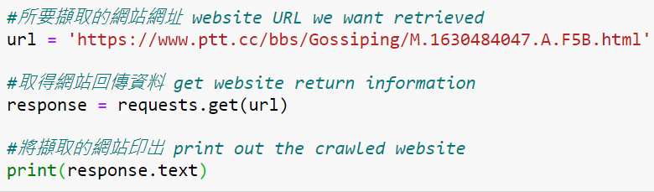
Get Website Source Code
get() function obtains the source code of the website and print out the crawled data in Jupyter Notebook.
You can use the URL:
https://www.ptt.cc/bbs/Olympics_ISG/M.1628431417.A.72F.html

Slide 18
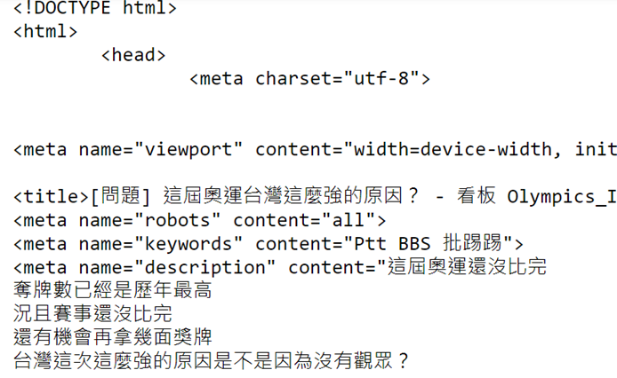
Print Website Data
The printed content will probably look like this:

Slide 19
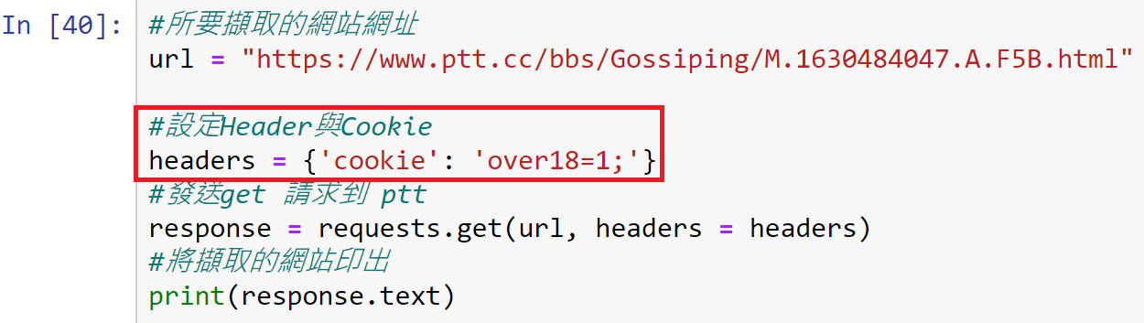
Hint
If the URL you entered has R-18 restrictions, you can use the following code to crawl pushes.

Slide 20
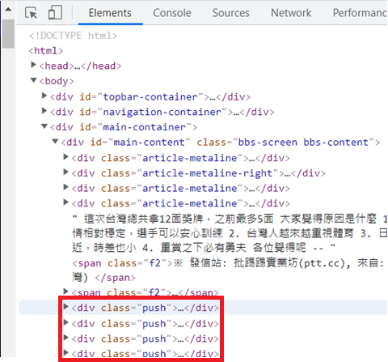
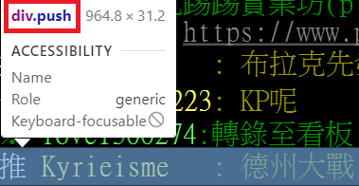
Search PTT Pushes
We can press F12 (Developer Tools) to observe where PTT’s pushes will be placed.
The pushes will be placed in the <div class = ‘push’>.

Slide 21
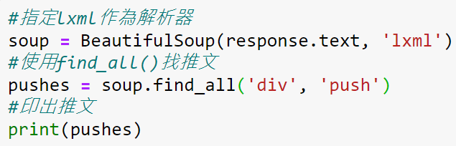
Use find_all() to Find Pushes
Use the find_all() function to operate BeautifulSoup to retrieve all the contents in <div class = ‘push’>.

Slide 22
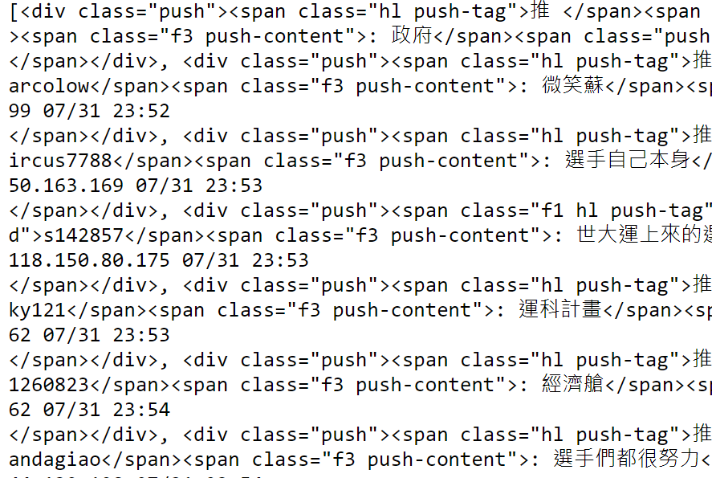
Print Out All Contents
Print out all the contents in <div class = ‘push’>.
The <div> and <span> HTML tags are still mixed in with the printed data, we need to remove them.

Slide 23
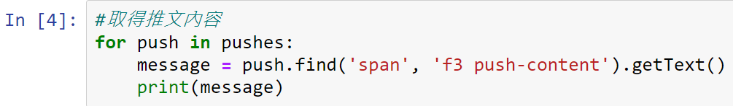
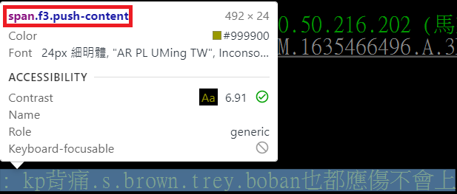
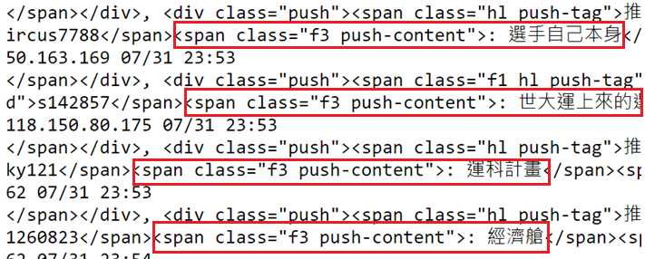
Retrieve Pushes
find() function only retrieves the pushes, and the pushes exist in <span class ="f3 push-content">.
getText() function gets text and catalog management.

Slide 24
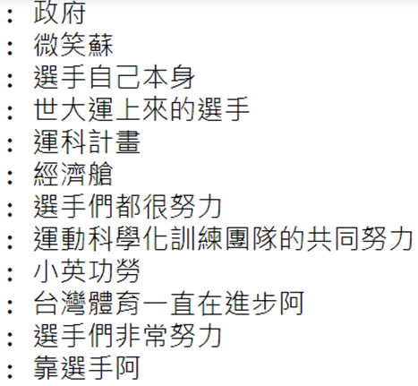
Retrieve Pushes (Cont’d)
The printed results are as shown below.

Slide 25
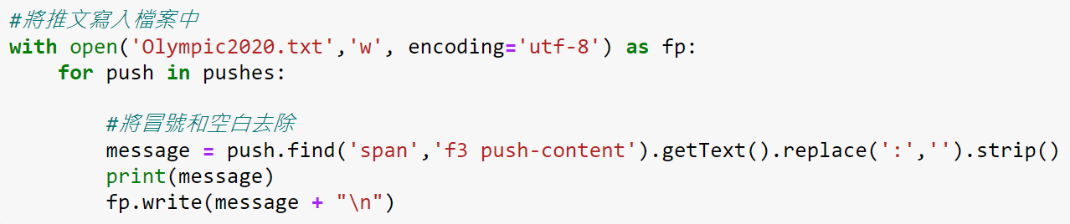
Remove Colons
replace() function removes the colon.
strip() function removes the spaces.
write() function writes the sorted data into the file.

Slide 26
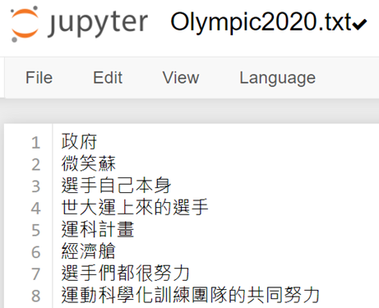
Remove Colons (Cont’d)
The pushes in the PTT saved without colons to Olympic2020.txt.

Slide 27
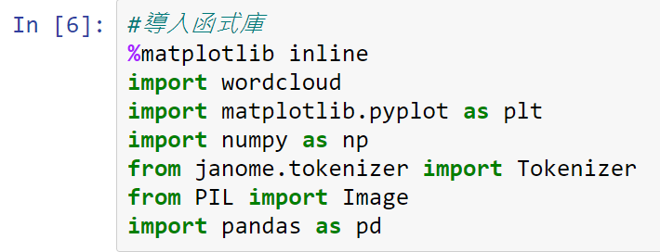
Start Drawing Word Cloud
wordcloud converts words to a word cloud.

Slide 28
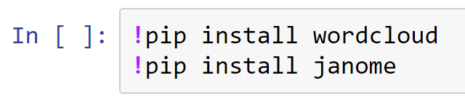
Install Package
Type !pip install (package name) in Jupyter to install the library.
Notes:
Exclamation Mark

Slide 29
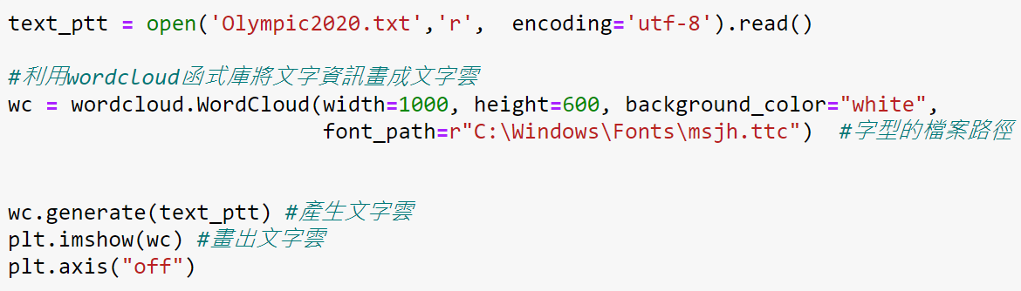
Generate Word Cloud
width & height sets the width and the height.
background_color sets the background color of the word cloud
font_path specifies the path of the font file.
generate() generates a word cloud.

Slide 30
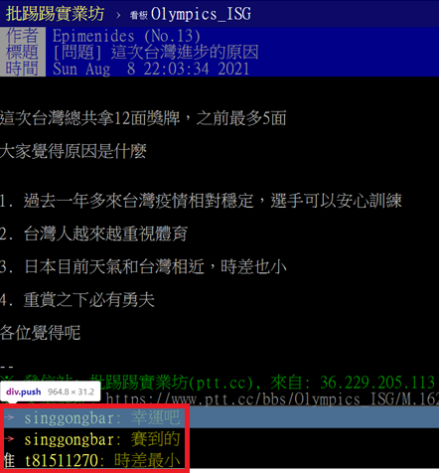

Word Cloud Output
https://www.ptt.cc/bbs/Olympics_ISG/M.1628431417.A.72F.html

Slide 31


Change Mask Image
First, we need to prepare a silhouette picture.
Upload the mask image we provided to Jupyter Notebook.
Please note that the image format must be .png and .jpg.
In the following example, we use the heart image as a word cloud mask.

Slide 32
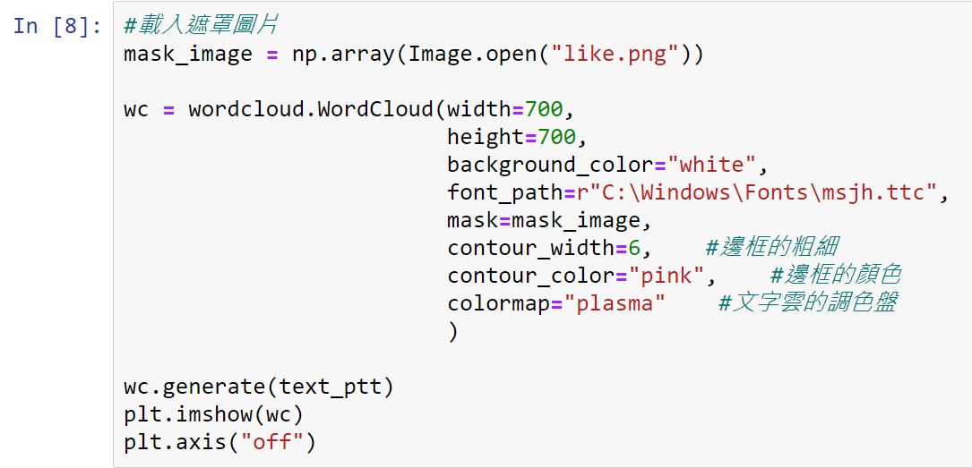
Change Mask Image (Cont’d)
mask specifies a mask image.
contour_width sets the thickness of the border.
coutour_color determines the border color.
colormap sets the colors of the text in the word cloud.

Slide 33
Change Mask Image (Cont’d)
Use imshow() to display the word cloud.
Use axis() and set its parameter to "off" so that the x-axis and y-axis will not be displayed in the word cloud.

Slide 34
Output of Change Mask Image

Slide 35
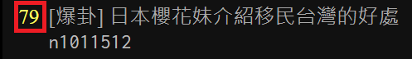

Exercise 1
Please find an article you are interested in on PTT and the number of pushes are greater than 50 to draw a word cloud.
Change the mask of word cloud above to a circle.

Slide 36


Exercise 1 Example

Slide 37
Line Chart
Use weather data on the internet to draw a temperature line chart.

Slide 38
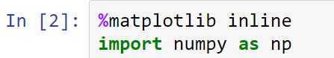
Numpy
numpy is a basic function library required for scientific operations using Python, including array operations that we will use later.
You can invoke the Numpy functions with np.
Load Numpy with import numpy as np.

Slide 39
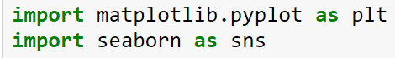
Matplotlib & Seaborn
matplotlib is a classic library for visualizing data with Python, available for Python development environments such as Jupyter Notebook.
seaborn is a Python library for visualizing data based on matplotlib, which makes visualizing statistical data more beautiful.

Slide 40
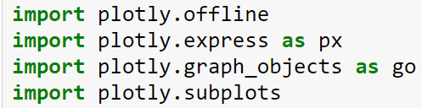
Plotly
plotly is a library that can draw dynamic charts and can also use preset values to beautify the chart.

Slide 41
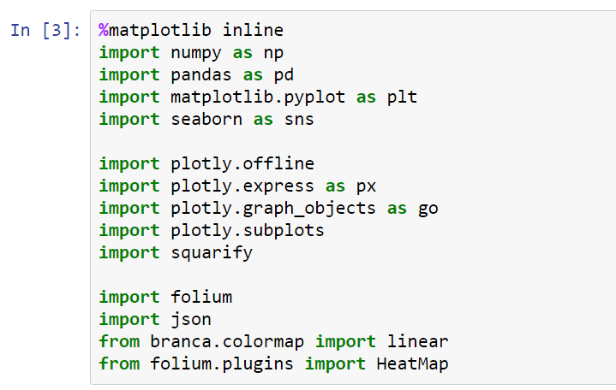
Import Full Library

Slide 42
Get Weather Data from Website
We provide you with the following two methods to obtain weather data from the website:
Click the download button on the website to download the file to your computer, and then upload the file to Jupyter notebook.
Use web crawlers to obtain website information and data.
URL link:
http://e-service.cwb.gov.tw/HistoryDataQuery/MonthDataController.do?command=viewMain&station=466920&stname=%25E8%2587%25BA%25E5%258C%2597&datepicker=2021-09

Slide 43
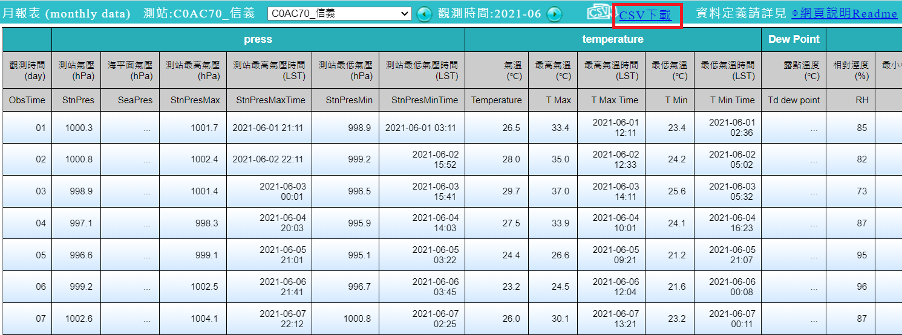
Method 1: Download File
You can use the URL we provided on the previous page to link to the website and download the data.

Slide 44
Method 1: Upload File to Jupyter
Upload the downloaded file to Jupyter Notebook.

Slide 45
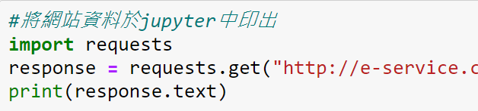
Method 2: Web Crawlers
Print out the website information in Jupyter to determine what data we need.

Slide 46
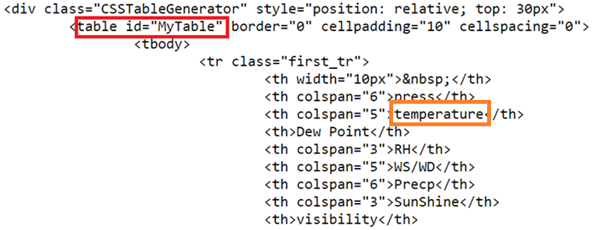
Method 2: Find Table ID
We can show the details of the webpage in Jupyter Notebook.
The weather data (temperature) we look for is in <table> and the table id is “MyTable”.

Slide 47
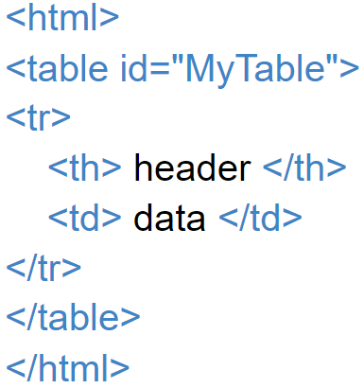
Method 2: <table>
<table> wrap the structure and content of the entire table.
<tr> (table row) define how many rows the table has.<tr> contains <td> (table data) and <th> (table header).
<td> defines how many columns the table has and <th> defines a header cell in an HTML table.

Slide 48
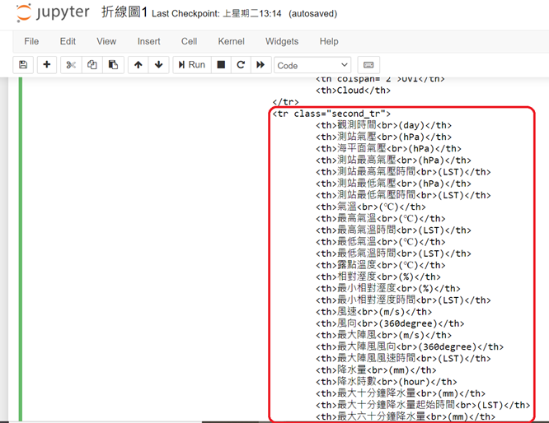
Method 2: Find the Data We Need
Find the weather data we need, and we can recognize that they are all wrapped in <tr>, <th> and <td>.

Slide 49
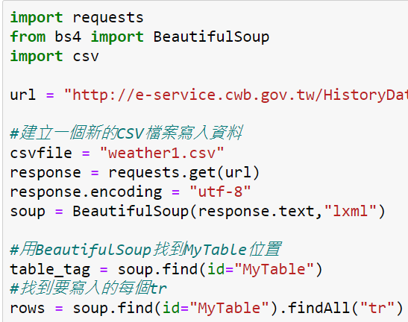
Method 2: Web Crawlers Detail
Notes:
url = “http://e-service.cwb.gov.tw/HistoryDataQuery/MonthDataController.do?command=viewMain&station=C0AC70&stname=%25E4%25BF%25A1%25E7%25BE%25A9&datepicker=2021-06”

Slide 50
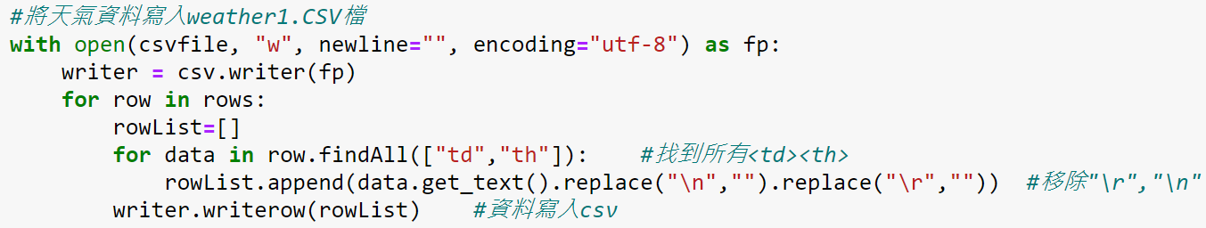
Method 2: Crawl the Data We Need
append() adds new objects at the end of the list.
writerows() writes all the elements in rows into the CSV file in corresponding data type.

Slide 51
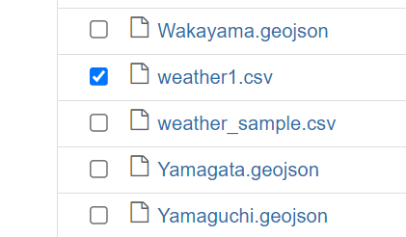
Delete the Data
We need to delete the excess data to avoid errors.
Go to Jupyter's home page to find weather1.csv and open it.

Slide 52
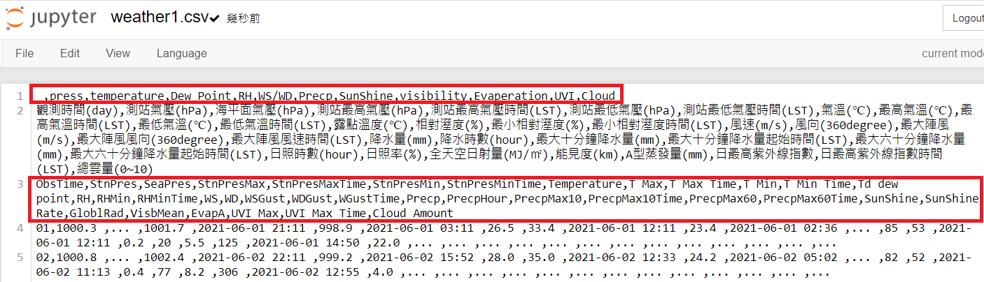
Delete the Data
Please delete data in the red box in the figure below.

Slide 53
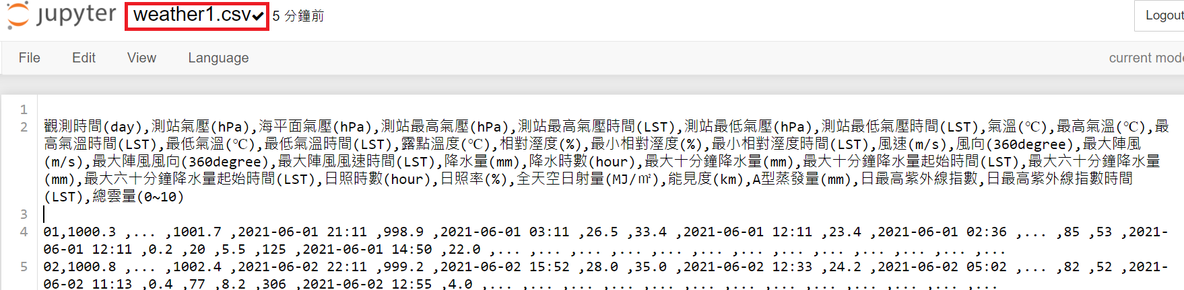
Web Crawler Execution Results
Please press “Ctrl” + “S” to confirm all the data has been written to the CSV file.

Slide 54
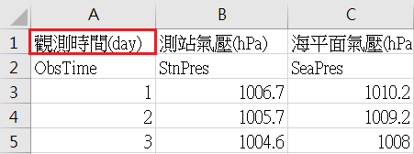
Load weather1.csv
Read the “觀測時間(day)” column from weather1.csv.
Specify the parse_dates parameter as “觀測時間(day)” to ensure that the line chart can be drawn with the timeline data.

Slide 55
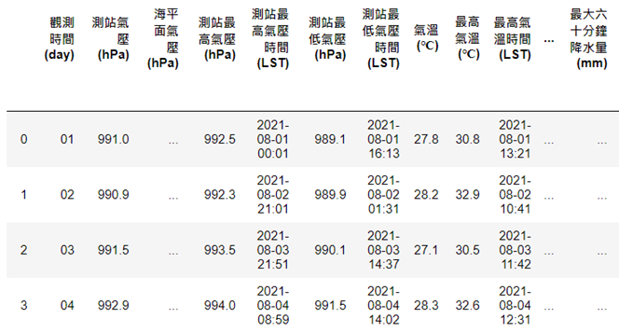
Load weather1.csv (Cont’d)

Slide 56
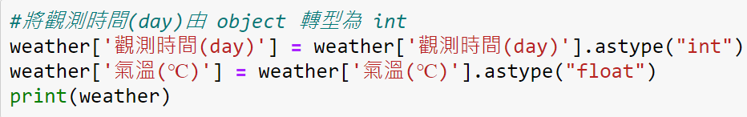
Data Type Conversion
The data type crawled by the web crawler may be an object, which may cause the problem that the line chart cannot be drawn.
We need to manually force it to int or float data type.

Slide 57
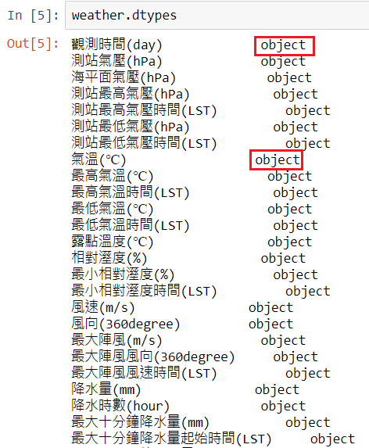

Data Type Conversion (Cont’d)

Slide 58

Draw a Line Chart
Line charts can be drawn with sns.lineplot().
Specify the horizontal axis as the parameter x, and the vertical axis as the parameter y.

Slide 59

Draw a Line Chart (Cont’d)
Temperature line chart.

Slide 60

Straighten the Horizontal Axis
If the string of the horizontal axis is too long, it may cause the scale to be covered.
We use xticks() to make the scale of the horizontal axis become straight.

Slide 61

Draw Multiple Line Charts
Create a data frame with “觀測時間(day)” as the first column.
Use the read_csv() function to load the CSV file and specify the index_col parameter as 0 to create a data frame with the “觀測時間(day)” column of the date data type as the index.
Load “氣溫”, “最高氣溫”, “最低氣溫” in the index and print out.

Slide 62

Draw Multiple Line Charts (Cont’d)
Data frame output:

Slide 63

Draw Multiple Line Charts (Cont’d)
Draw the legend with legend().
Set loc parameter to change the position of legend shown.

Slide 64

Draw Multiple Line Charts (Cont’d)
There are three different types of line charts.

Slide 65

Set Line Charts to Same Type
Put the data to be adjusted in the same column and adjust them (“氣溫種類”).
rename_axis() is to rename the axis of the index or columns in data frame.
reset_index() is to reset the index of a data frame.
Use the rename() function to change the column name to "溫度(℃)".

Slide 66

Set Line Charts to Same Type (Cont’d)
Combine “氣溫”, “最高氣溫”, “最低氣溫” into a single column named “氣溫種類”.

Slide 67

Set Line Charts to Same Type (Cont’d)
Use the parameter hue to specify the column to be drawn.
In this example, we specify “氣溫種類” to draw a line chart in different colors.
The types of line charts will be the same, but the color will be different.

Slide 68

Set Line Charts to Same Type (Cont’d)
Compared to the previous line chart, the type of lines will be the same.

Slide 69

Highlight One of Line Charts
Use the len() function and the unique() function to calculate the number of categories of “氣溫種類”.
Use the parameter color_palette() of the sns.lineplot to change the color of the palette.

Slide 70

Highlight One of Line Charts (Cont’d)

Slide 71

Highlight One of Line Charts (Cont’d)
“氣溫(℃)” is highlighted in red.

Slide 72

Use plotly to Draw a Line Chart
If you use plotly to draw a line chart, the code is simple and the data can be displayed dynamically.
For example, when the mouse is moved on the line chart, the value at each point will be displayed.
Use line() function to draw a line chart.
Use show() function to display line chart.

Slide 73

Use plotly to Draw a Line Chart (Cont’d)
The line chart drawn by plotly.

Slide 74

Use plotly to Draw Multiple Line Charts
To use plotly to draw multiple line charts, you must define each line chart then gather the line charts in a single chart.
Specify “lines” in the parameter mode of the Scatter() function to create line chart data of different temperatures.
Our X-axis is “觀測時間(day)”, and Y-axis are different types of temperature.

Slide 75

Use plotly to Draw Multiple Line Charts (Cont’d)
To combine multiple line charts into a single chart, specify the parameter data of the Figure() function to combine data in different “氣溫種類” (tmp_ave, tmp_high, tmp_low).

Slide 76

Use plotly to Draw Multiple Line Charts (Cont’d)
Data output:

Slide 77

Use plotly to Draw Multiple Line Charts (Cont’d)
Multiple line charts drawing by plotly:

Slide 78

Smooth the Line Chart
Use the scipy library to smooth the line of the line chart.
The linspace() function in Numpy can spread points evenly within a certain range.
For example, if we want to generate 10 points between 1 and 5, our program can be written as follows.

Slide 79

Smooth the Line Chart (Cont’d)
Use make_interp_spline() to determine the coefficients of the spline to draw a smooth line chart.
We plot the curve by taking 300 equally spaced samples between the minimum and maximum values along the x-axis.

Slide 80

Smooth the Line Chart (Cont’d)
The scatter chart can be drawn with the scatter() function.
The parameter color can specify the color of the dots, and the parameter alpha can specify a value between 0 and 1. Make the color of the dots transparent.

Slide 81

Smooth the Line Chart (Cont’d)

Slide 82

Smooth the Line Chart (Cont’d)
The output after smoothing the line chart.

Slide 83

Smooth the Line Chart (Cont’d)
Establish x-axis and y-axis matrix as "觀測時間(day) and "氣溫(℃)“ than smooth the data.

Slide 84

Smooth the Line Chart (Cont’d)
Use the title() function to add a title to the line chart.
Use the x.label(), y.label() functions to add labels to the x and y axis.

Slide 85

Smooth the Line Chart (Cont’d)

Slide 86

Smooth the Line Chart (Cont’d)
The output after smoothing the line chart of weather data.

Slide 87

Chinese Display Problem
If you have encountered an abnormal display of Chinese, please go to the URL provided by us, and follow the instructions of the website to solve the abnormal display.
URL link: https://www.getit01.com/p20190120250957403/

Slide 88
Exercise 2
Please get the weather data for any month and any region from the website we provide. Draw the "氣溫(℃)", "最高氣溫(℃)", and "最低氣溫(℃)" as a line chart and highlight the "最高氣溫(℃)".
Draw "氣溫(℃)", "最高氣溫(℃)", and "最低氣溫(℃)" as a line chart and smooth it.
URL link: http://e-service.cwb.gov.tw/HistoryDataQuery/MonthDataController.do?command=viewMain&station=C0AC70&stname=%25E4%25BF%25A1%25E7%25BE%25A9&datepicker=2021-09

Slide 89


Exercise 2 Example

Slide 90
Heat Map
Use Covid-19 related data to draw heat maps.

Slide 91

Draw a Heat Map
Load the library we will use.

Slide 92

Draw a Map of the Administrative Regions of the United States
Use the parameter location of the folium.map() function to specify the latitude and longitude.
zoom_start is the zoom level of the map. The smaller the value, the larger the coverage of the map.

Slide 93

Draw a Map of the Administrative Regions of the United States (Cont’d)
Use the folium.Choropleth() functions to draw a colored map of the US.
The add_map() function can add color, transparency, border color, and thickness to our base_map.
The json library is used to import data (because usually, map files are JSON files).

Slide 94

Draw a Map of the Administrative Regions of the United States (Cont’d)

Slide 95

Number of Cases of COVID-19 in U.S. States
Create a CSV file (named covid_usastate) of the number of people diagnosed with Covid-19 in each state in the United States. Use this file to draw a heat map.
https://www.worldometers.info/coronavirus/country/us/

Slide 96

Heat Map of Cases Diagnosed with COVID-19
The read_csv function can help us read CSV files stored in Jupyter.
Import covid_usastate.csv with the data parameter to read the Covid-19 confirmation cases for each state.
The fill_color parameter is used to set the heat map palette.

Slide 97


Heat Map of Cases Diagnosed with COVID-19 (Cont’d)
The columns parameter is used to specify the name of the key (e.g. USA State, Total Cases) in the column where the heat map is drawn.

Slide 98

Heat Map of Cases with COVID-19

Slide 99
Convert Total Cases into Ratio
Because the uneven distribution of the population, the previous picture failed to show the actual severity of each state truthfully.
Add the population of each state and convert the number of diagnosed cases into a ratio to increase readability of the data.
We create another CSV file (new_covid_usastate) and draw the heat map with the ratio of diagnoses cases in each state.

Slide 100

Heat Map of Ratio Diagnosed with COVID-19
We reload the new data (new_covid_usastate), and then we modify the key in the columns parameter from “Total Cases” to “Rate”.

Slide 101

Heat Map of Ratio with COVID-19

Slide 102
Exercise 3
Please go to the GitHub folder we provided, download, and upload all files to Jupyter Notebook at first.
Draw the number of death cases of COVID-19 in U.S. states as a heat map.
Draw the heat map of death rate with COVID-19 in U.S. states.
You need to sign in GitHub to download files.
GitHub link: https://github.com/emotionmax/Python-Data-Visualization/tree/main/Data
Please draw a heat map based on the Death_cases and Death_rate in covid_us_states.csv according to the file we provided in GitHub.

Slide 103

Exercise 3 Example

Slide 104

Exercise 3 Example (Cont’d)

Slide 105
Exercise 4
Search the information on the internet you are interested in and draw it to a heat map.
For example, GDP per capita in various countries, global vaccine coverage, number of confirmed cases of COVID-19 in Japan, etc.
There are no restrictions, you can do whatever you want.

Slide 106
Thanks.

